Slide 1
Tantin Group
PROJECT PROPOSAL
Boundless Endeavors, Tantin is Everywhere
Tantin as a Metaphor • Connecting and Coexisting

Slide 2
I.Tantin Goals
Six Major Goals for 2025-2035
Tantin Group is rooted in the global Web3 and AI industries, focusing on the next 10 years. With forward-looking strategic planning and innovation-driven initiatives, we have established six grand goals:

Slide 3
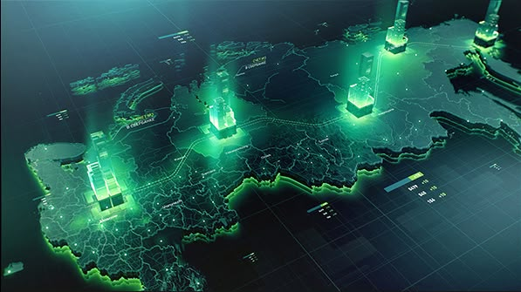
1.Tantin Public Chain：
To become the world's largest public chain by 2028.
The Tantin Public Chain is a high-performance,highly scalable blockchain protocol independently developed by Tantin Group,designed for the global Web3 and AI ecosystems.It aims to become the core infrastructure of the digital economy era.
Through technological innovation and architectural optimization,the Tantin Public Chain effectively addresses the performance bottlenecks,high costs,and ecosystem fragmentation of traditional blockchains.It provides secure,efficient,and scalable underlying support for decentralized applications(DAPPs),digital assets, cross-chain collaboration,and AI-driven smart contracts.
The plan is to develop into the world's largest public chain within three years,leading the innovation and popularization of blockchain technology.

Slide 4
2. Tantin Coin：
Market capitalization exceeding $200 trillion.
Tantin Coin is the native token of the Tantin Public Chain and the core asset of the entire Tantin ecosystem.
It serves as both a medium of value exchange and an essential component of ecosystem governance and incentive mechanisms.Tantin Coin aims to become a cornerstone of the global Web3 and AI ecosystems.
With a strong technical R&D team,global operational strategy deployment,ecosystem development,innovative incentive mechanisms,and an extreme deflationary mechanism, Tantin Coin will achieve the largest user base and empower real-world applications, driving continuous market capitalization growth and becoming one of the world's most valuable digital assets.
Forecast:
First Month: $300 million USD，Second Month: $500 million USD，Third Month: $800 million USD，Annual Goal: $6 billion USD
Second phase: Continuous growth for 10 years.
Tantin as a Metaphor • Connecting and Coexisting

Slide 5
3.Breakthrough 10 Million+ Token Holders
Leveraging global node campaigns, innovative incentive mechanisms, and a top-tier technological ecosystem, Tantin Group is confident in surpassing 10 million+ token holders.
Leveraging global node elections,innovative incentive mechanisms,and top-tier technical ecosystem strength,Tantin Group is confident in achieving this milestone.Supported by the high-performance Tantin Public Chain and diverse application scenarios,precise marketing and global partner support will ensure broad coverage of target markets.
Combining the explosive growth of Web3 and AI with the deflationary appreciation potential of Tantin Coin, Tantin will lead the industry in achieving a historic breakthrough in user scale,becoming the digital asset of choice for global users.

Slide 6
4. Massive Web2 and Web3 User-Built Tantin Digital Currency Exchange
Leading in user experience,security,trading depth,and diversified high-quality services,while ensuring compliance with local regulatory requirements.
Goal:To become the preferred exchange for global users,surpassing Binance in liquidity,user scale,and asset reserves.

Slide 7
5.Tantin Stablecoin — The Most Widely Used Stablecoin Globally
To become the most widely used stablecoin globally.
Transparent reserve mechanisms,strong liquidity support,and global compliance layout,setting a new industry benchmark for compliance and trust.
USDY

Slide 8
6.Creating 10 Million+ Millionaires and 100,000 Billionaires
Through the appreciation of Tantin Coin,profit-sharing from the exchange, and ecosystem incentive programs, Tantin Group aims to become the world's largest company by market capitalization within 10 years,helping 10million+ users become millionaires and 100,000 users become billionaires.
Tantin Group,with technological innovation and ecosystem empowerment at its core,will inspire global users'wealth growth and influence explosion.Over the next decade,it will lead the digital economy wave and reshape the global value landscape!

Slide 9
II. Core Ecosystem

Slide 10
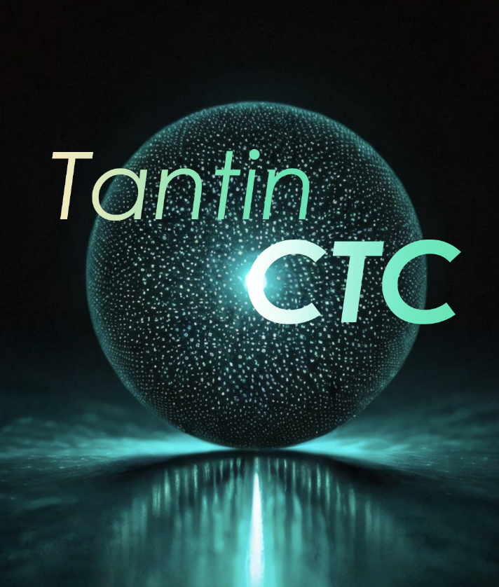
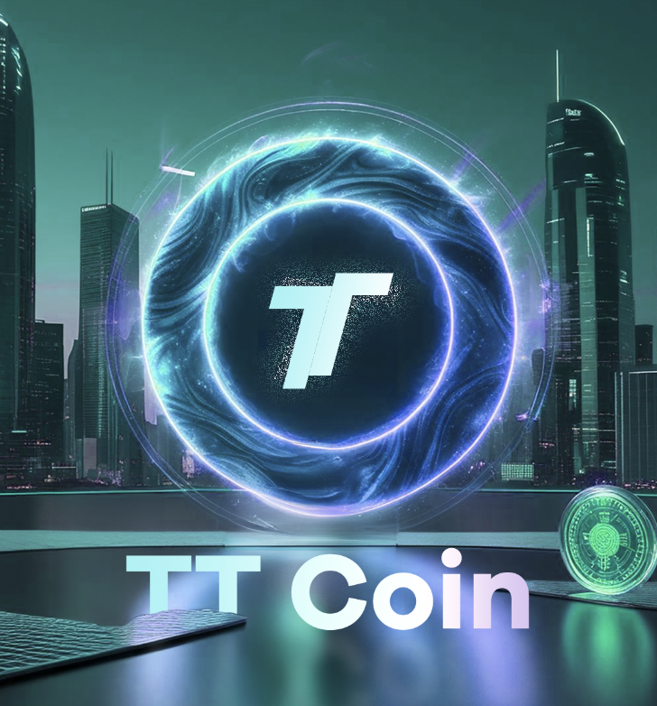
Core Ecosystem
1.Tantin Public Chain (CTC)
2. Tantin Coin (TT Coin)
Technical Features:
High throughput:Supports massive transaction processing.
Smart contracts: Convenient development components adaptable to multiple industry scenarios.
Cross-chain interoperability: Enables seamless connections between different blockchain ecosystems.
Openness:Provides developers with rich tools and resources to promote ecosystem prosperity.
Functional Positioning:As the core token of the ecosystem,it is used for paying transaction fees, participating in platform governance, and ecosystem incentives.
Issuance Mechanism:Adopts a transparent distribution mechanism, reserving a portion of tokens for ecosystem development, developer support, and community incentives.

Slide 11
Core Ecosystem
3.Tantin Digital Currency Trading Platform
Core Functions:Supports spot trading, leveraged trading, contract trading, staking mining, lending, AI coin selection, and AI strategy education.
Innovative Highlights:AI-driven risk control system for real-time monitoring and responseto potential risks; user-friendly interface design to enhance trading efficiency and experience.
4.Tantin Stablecoin
(USDY)
Advantages:Pegged to mainstream fiat currencies, adopting multi-layered reserve and audit mechanisms to ensure stability and transparency.
pplication Scenarios:Payments,smart contract settlements,cross-border remittances,and value storage.

Slide 12
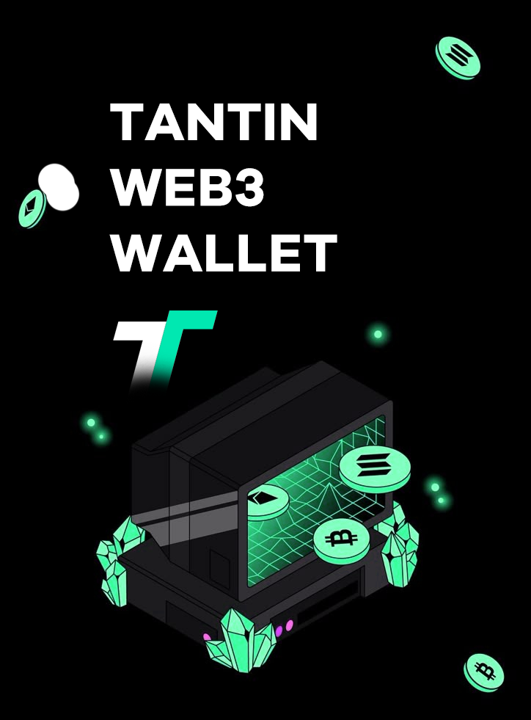
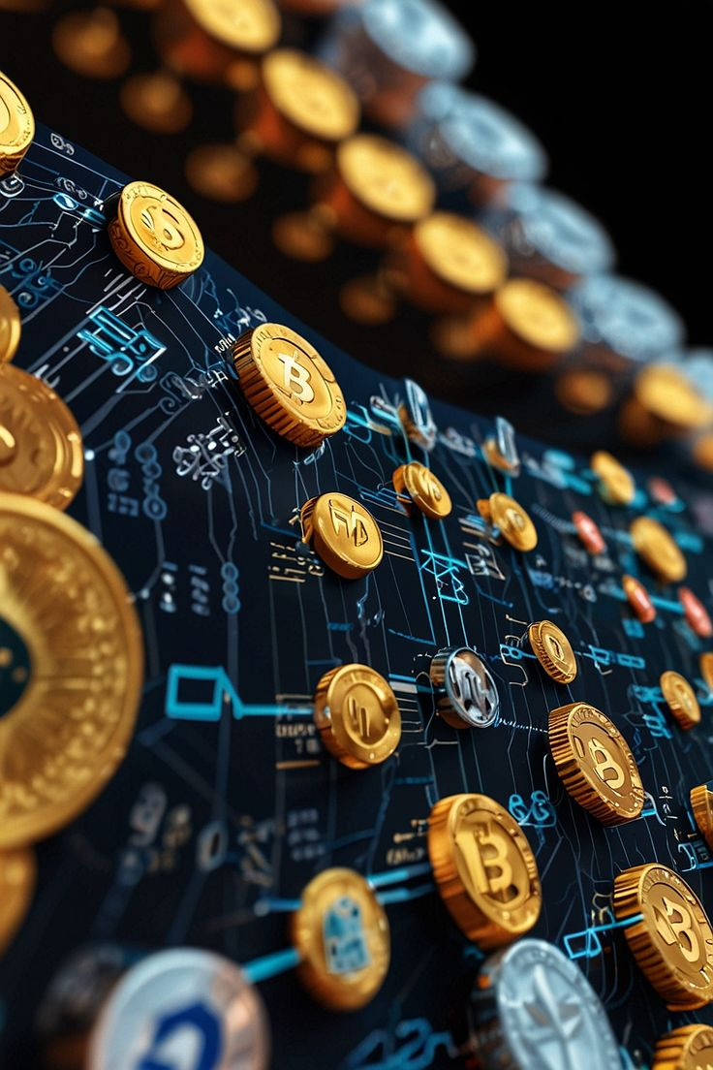
Core Ecosystem
5.Tantin Web3 Wallet
Core Functions:Multi-chain asset management,DApp interaction,NFT storage,cross-chain trading,and Web3 and AI service integration.
User Experience:Employs the highest level of security protocols while providing a simple and intuitive user interface.
6.Tantin Laboratory
Research Directions:Blockchain privacy protection,DeFi innovation mechanisms,NFT standard optimization, Web3 and AI technology integration, and new application development.
Support Mechanisms:Establishes developer reward programs to drive technological innovation and application implementation.

Slide 13
III. Four Major Revenue Sources of Tantin Group

Slide 14
Four Major Revenue Sources
1.Bank Reserves
Tantin Stablecoin will adopt a strict fiat reserve mechanism, generating long-term stable cash flow through bank deposit interest and financial investment income.

Slide 15
Four Major Revenue Sources
2.Public Chain Revenue：GAS fees,cross-chain bridges, and DEX’s multiple profit engines
GAS Fees: Each transaction on the Tantin Public Chain requires a GAS fee to support the chain's operation and security.
Cross-Chain Bridge Revenue: The Tantin Public Chain features an efficient cross-chain bridging protocol, supporting asset interoperability with mainstream blockchains like Ethereum, Bitcoin, and Solana. Each cross-chain transfer charges a certain fee.
Decentralized Exchange (DEX) Revenue: The DEX deployed on the Tantin Public Chain generates income through transaction fees, liquidity mining incentives, and listing fees.

Slide 16
Four Major Revenue Sources
3.Exchange Transaction Fee Revenue
The Tantin Exchange will charge fees for spot trading,derivatives trading,and lending services,continuously optimizing services to attract more users and form a stable revenue source.
4.Stablecoin Issuance Profit
The circulation scale of Tantin Stablecoin will grow rapidly with ecosystem expansion, generating substantial income through the management fees of locked fiat assets.

Slide 17
IV. Profit Distribution Mechanism
Tantin Coin to Rise Continuously for 10 Years,with a 100,000-Fold Increase

Slide 18
Through six major destruction mechanisms,Tantin Coin achieves strong deflationary attributes:
1
80% of Tantin Stablecoin (USDY) transfer fees are used to buy and destroy Tantin Coin, while 20% is allocated for operational expenses.
4
80% of stablecoin interest is used to buy and destroy Tantin Coin, while 20% is allocated for company operational expenses.
2
80% of contract-related profits are used to buy and destroy Tantin Coin, while 20% is allocated for company operational expenses.
5
80% of listing fees are used to buy and destroy Tantin Coin, while 20% is allocated for company operational expenses.
3
80% of GAS fees are used to buy and destroy Tantin Coin, while 20% is allocated for company operational expenses.
6
80% of Tantin Coin (CTC) transfer fees are used to destroy Tantin Coin, while 20% is allocated for company operational expenses.
Tantin as a Metaphor • Connecting and Coexisting

Slide 19
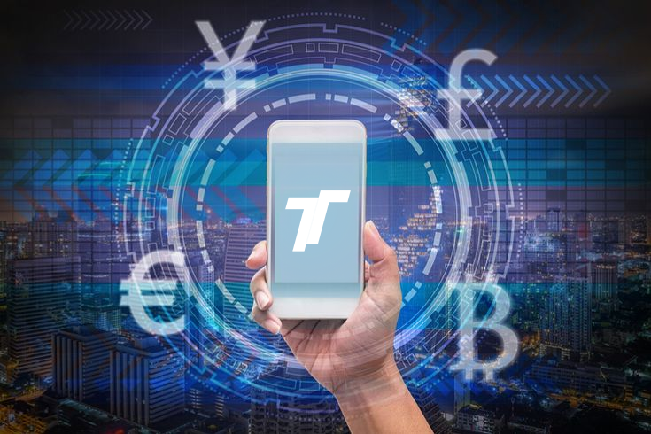
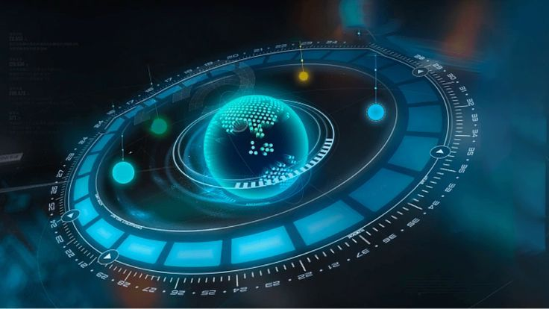
The world's first economic incentive model
Multiple ecological binding
Circular Economy Model
User win-win mechanism
Through the four core revenue sources of stablecoin issuance, exchange fees, public chain transfer fees and legal currency reserves, Tantin Coin is fully bound to ecological application scenarios.
The income will be used for destruction, continuously optimizing the supply and demand relationship and driving up the value of Tantin Coin.
The core of the economic model is to motivate ecological participants. Every transaction and participation of users can boost the growth of the market value of Celestial Coin and achieve common prosperity of the ecology.

Slide 20
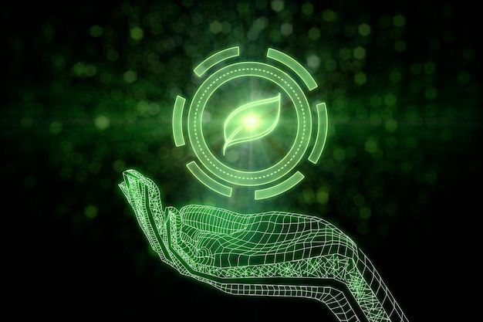
Market value management advantages
Strong deflationary properties
Market confidence increases
Steady development of ecology
A stable and transparent income distribution mechanism sends a signal of long-term development to the market,enhancing user trust and willingness to hold.
Through large-scale destruction, continuous supply reduction is achieved,enhancing the value of tokens.
Through stable operations and market incentive funds,we support the ecosystem's technological innovation and user growth to ensure long-term competitiveness.

Slide 21
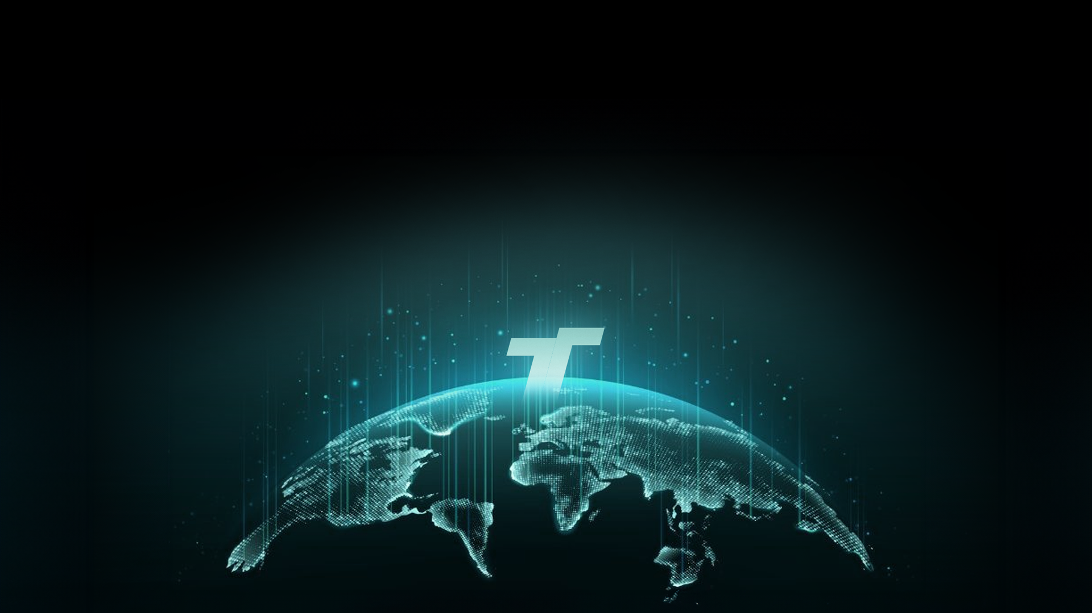
Tantin Group relies on its unique revenue source and the world's first economic incentive model to achieve a virtuous cycle between Tantin coin market value management and ecological development.
With its unique revenue source and the world's first economic incentive model, Tantin Group achieves a virtuous cycle between Tantin coin market value management and ecological development. Through a multi-dimensional revenue model and a transparent and efficient fund allocation strategy, Tantin Group will not only push Tantin coin market value to exceed the expected target, but also build a sustainable Web3 and AI digital economic system to help global users and partners achieve win-win results.

Slide 22
V.Project Implementation Plan

Slide 23
Project Implementation Plan
Phase 1:
Initial Preparation and Brand Establishment(1 Year)
Team building and compliance work:
Complete the construction of the core team and confirm various senior positions (such as Asia Pacific Operations Director, CTO, CFO, etc.).
Register a compliant company, apply for necessary qualifications and licenses, and ensure compliance with legal and regulatory requirements around the world.
Teacher Yu will give a lecture - the first ten consensus conferences to expand brand influence and promote recognition from global users and partners.
20 global campaigns - global nodes
Complete the design and testing of Celestial Coin and Celestial Stable Coin to ensure technical feasibility.
Platform construction and first phase of ecological implementation:
Release the first version of the Tantin digital currency trading platform, providing basic spot trading, leveraged trading and staking mining functions.
Release the basic version of the Tantin Web3 wallet, supporting multi-chain asset management and simple DApp interaction.
Start the research and development of the Tantin public chain and improve the technical architecture.

Slide 24
Project Implementation Plan
Phase 2:
Product Expansion and User Growth(2-3 Years)
Tantin public chain test network:
Launch the Tantin public chain test network to attract developers to participate and promote the development of decentralized applications.
Optimize the performance of the Tantin public chain and add more smart contract functions and cross-chain interoperability.
Trading platform and wallet expansion:
Improve the Tantin trading platform and launch more new features such as trading pairs, leveraged trading, and derivatives trading.
Enhance the functions of the Tantin Web3 wallet, add NFT storage, cross-chain transactions, and more DApp access.
Introduce AI coin selection and strategy education functions to attract more users to use the trading platform.
Marketing and ecological incentives:
Launch global marketing to attract more users to join the celestial ecology, and strive to launch an additional 10 million+ coin holders.
Introduce an ecological incentive plan to promote the participation and contribution of developers and community members.

Slide 25
Project Implementation Plan
Phase 3:
Global Expansion and Deep Collaboration(4-6 Years)
Tantin Coin Market Value Breakthrough:
Achieve a market value breakthrough of 200 trillion US dollars for Tantin Coin, becoming an important component of the global Web3 and AI ecosystem.
Promote Tantin Coin to become the mainstream in the field of digital assets, develop global ecological applications, and promote the continuous growth of market value.
Build the world's largest digital currency trading platform:
Tantin Trading Platform has become the preferred exchange for global users, supporting transactions of multiple fiat currencies and digital currencies.
Strengthen platform security and user experience, and launch more innovative trading products.
Introduce more global partners to expand the exchange's global market share.
Celestial Stablecoin becomes mainstream:
Celestial Stablecoin gradually replaces USDT and becomes the preferred stablecoin for global users, leading the standards of compliance and transparency.
Expand the application of Celestial Stablecoin in multiple scenarios such as payment, cross-border remittance, and smart contract settlement.

Slide 26
Project Implementation Plan
Phase 4:
Technological Innovation and Global Governance(7-9 Years)
Tantin public chain becomes the core infrastructure:
Realize the global application of Tantin public chain, become the digital economic infrastructure, support large-scale commercial applications and developer ecology.
Provide more decentralized finance (DeFi) functions and conduct cross-chain interoperability with more blockchain ecosystems around the world.
Combining technological innovation with AI:
The Astronomical Laboratory will continue to promote research and innovation in the fields of blockchain privacy protection, DeFi innovation mechanisms, and AI technology integration.
Deeply integrate AI technology with Web3 applications, launch AI-based digital asset management, investment decision-making and other tools, and enhance user experience.
Global governance and decentralization:
Complete the construction of a global decentralized governance framework, and the community and developers will jointly participate in the decision-making and management of the celestial ecology.
Promote the legalization of celestial currency on a global scale, obtain the recognition of local regulators, and establish a more complete compliance mechanism.

Slide 27
Project Implementation Plan
Phase 5:
Global Influence and Future Prospects(10 Years)
Tantin becomes the world's leading
Web3 and AI platform:
Tantin Group has gained extensive influence around the world and has become a leader in the digital economy.
Create 100,000 global billionaires through Web3 and AI-driven wealth redistribution.
Market value management and ecological stability:
Through destruction and market incentive mechanisms, continue to promote the growth of the market value of Tantin Coin and ensure the scarcity and value of tokens.
Provide a strong user win-win mechanism to ensure the healthy development of the Tantin ecology and promote the sharing of global wealth.
Future expansion of Tantin:
Achieve unlimited expansion in technology, ecology and market, promote more innovative business models and application scenarios, and continue to lead the future development of Web3 and AI.

Slide 28
WEB3 & AI
By building a complete Web3 and AI ecosystem,Tantin Group provides innovative digital financial services to global users, developers and enterprises. The practical application value of Web3 and AI technologies will also promote the sustainable development of the global digital economy.

Slide 29
Core Value Philosophy of Tantin
Cosmic Philosophy, Digital Future
"Tantin",as the core value philosophy, endows the project with profound philosophical significance and strategic direction for future development. Through the breadth and depth of the cosmos, using Tantin as a metaphor,it reveals the essence of Web3 and AI technologies and conveys the vision of breaking boundaries,connecting and coexisting, and infinite innovation.

Slide 30
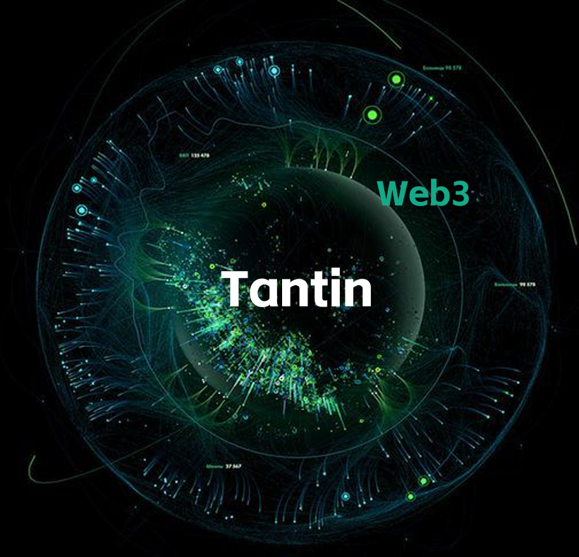
Definition and Symbolism of Tantin
1.Definition and Symbolism of Tantin
Harmony between the whole and the individual: The universe is a whole composed of countless celestial bodies, and each celestial body is an indispensable individual. The Celestial Group is committed to building a decentralized ecosystem, connecting all nodes closely, and forming an indivisible Web3 world.
Ecological interconnection: This combination embodies the core spirit of blockchain "decentralization". All individuals collaborate in equality to form a powerful ecological force and promote the development and evolution of the whole.
2. Powerful energy
Unlimited potential: Just as the universe contains infinite energy, celestial bodies represent the potential and vitality in the digital economy.
Multi-dimensional empowerment: This energy is reflected in four dimensions:
Technological innovation: Based on the celestial public chain, it continuously promotes performance, compatibility and security.
Funding support: Through diversified income models, it injects strong momentum into the sustainable development of the ecosystem.
User consensus: Through strong community collaboration and consensus, a stable and strong user base is formed.
Global influence: With cutting-edge concepts and technological advantages, it radiates the world and promotes the widespread implementation of the ecosystem.
3. Unlimited business
Crossing traditional boundaries: Celestial bodies imply breaking through the limitations of traditional industries, regions and technologies, and creating a new era of Web3 that integrates technology, economy and culture.
Infinite extension pattern: Just as the universe continues to expand, Celestial bodies' business is boundless, committed to achieving global development, and becoming the core promoter of the Web3 world.

Slide 31
Tantin's Core Values
1. Connection and symbiosis
Synergistic ecology: Tantin emphasizes the synergy between individuals and the whole, relying on technology and economic models to seamlessly connect users, developers and investors to jointly build a prosperous WEB3 ecosystem.
Value sharing: Through Web3 and AI technology and economic incentive models, promote fair distribution of value and achieve win-win results for ecological participants.
2. Infinite possibilities
Endless innovation:Tantin's boundlessness symbolizes the eternal pursuit of innovation and exploration. Through modules such as public chains, stablecoins and trading platforms, new business models and application scenarios are constantly generated.
Future potential:Tantin ecology is the starting point of countless possibilities. Every innovation has a profound impact on users and the global economy.
3. Inclusiveness and win-win
Global wealth sharing:Tantin uses economic incentive mechanisms to enable ordinary people to achieve wealth growth and economic freedom, and promote the universalization of wealth distribution.
Consensus-driven prosperity: With "consensus" as the core concept,Tantin encourages global users to participate through fair and transparent ecological rules to jointly promote ecological prosperity and sustainable growth.

Slide 32
Extension of Tantin Spirit
1. Technical level: Stability and unlimited expansion
Equal emphasis on stability and innovation: Tantin's technical architecture is as stable as the universe, and it has a variety of functional expansions like galaxies to ensure the long-term development of the ecosystem.
Unlimited scalability: Through the high-performance Tantin public chain and cross-chain interoperability, it provides a solid foundation for decentralized applications, smart contracts and global services.
3. Cultural level: breadth of thought and global influence
Cognition determines height: through community education, technology popularization and consensus dissemination,Tantin advocates in-depth exploration of ideas and leaps in cognition, promoting users' comprehensive understanding of blockchain and digital economy.
Attract global resources and power: Like Tantin's gravitational field, the project attracts global users, developers and partners through strong vision, technical strength and business model to jointly promote the development of Tantin ecology.
2. Economic level: Strong engine and global layout
Diversified income model:Tantin forms a strong economic self-circulation system through multi-dimensional income sources such as stablecoin issuance income, trading platform fees, GAS fees and bank reserve income.
Global economic strategy: Combine the resource advantages of various regions to build a global blockchain ecosystem and realize the global implementation and development of the ecological layout.

Slide 33
Tantin 's unique philosophical implication
1. Taking "sky" as the vision, expanding the vision of globalization
Tantin takes the universe as a reference, reflecting the global pattern that transcends regional and industry boundaries.
Through the multi-dimensional combination of technology, economy and culture,Tantin has created boundless future possibilities for users and partners.
2. Taking "body" as the core, aggregate individual value
Tantin regards every user as an important part of the ecosystem.
Through collaboration and consensus, every individual can realize their own value in the ecosystem and become an important force to promote overall development.
3. Guided by "philosophy", promote technological and economic innovation
The philosophy of Tantin stems from a deep insight into the universe, Web3 blockchain and AI, focusing on both the stability of technology and the sustainable development of the ecosystem.
Guided by this philosophy,Tantin is not only a technological innovator, but also a thought leader in the digital economy era.

Slide 34
Boundless Endeavors,Tantin is Everywhere
"Tantin"is not just the name of a project but a philosophical expression of the future Web3 and AI world.
Taking "all universe individual combinations" as the starting point, Tantin not only focuses on the innovation of technology and business models, but also strives to promote the globalization, inclusiveness and sustainable development of the digital economy.Tantin, with its strong vision, unlimited potential and continuous innovation, will break through traditional boundaries, create a truly boundless career blueprint, and lead the brilliant future of Web3 and AI era!
——Yu Lingxiong
Chairman of Tantin Group
Tantin as a Metaphor • Connecting and Coexisting

