Slide 1
Tantin Chain
The No.1 Super Traffic Public Chain,
A Never-Congested Web3 Hub
Tantin Chain - Traffic Engine

Slide 2
01
Introduction

Slide 3
01
Tantin Chain
Introduction
Tantin Chain is a next-generation public chain designed for massive users and high-frequency interactions. Positioned as a "traffic engine," it redefines blockchain scalability.
Through its proprietary dynamic sharding technology and intelligent resource allocation system, the chain’s processing capacity scales in real-time with traffic growth. Tested to handle tens of thousands of transactions per second (TPS) with 3-second finality, it aims to resolve the congestion and high latency plaguing traditional chains. Full nodes secure the network, while light nodes enable millisecond-level verification.
The AI-powered resource scheduler dynamically allocates computing power—equipping blockchain with a "traffic navigation system" to ensure seamless data flow.

Slide 4
01
Tantin Chain
Introduction
Tantin Chain is building a self-reinforcing flywheel:
More users → Higher on-chain activity → More token burns → Stronger value foundation → More developers → More users.
For the first time, blockchain truly matches internet-scale traffic, enabling Web3 to serve billions.
Tantin Chain provides developers with high-performance, low-cost blockchain infrastructure to drive decentralized applications (dApps) and digital assets.
Developers can migrate to Tantin Chain with minimal effort, tapping into millions of EVM-compatible users.

Slide 5
02
Core
Architecture
Design

Slide 6
02
Tantin Chain
Core Architecture Design
Blockchain Foundation
Consensus Mechanism
A Proof-of-Stake Authority (PoSA) variant ensures an average block time of 3 seconds, supporting tens of thousands of TPS. Low transaction costs make it ideal for micropayments and batch transactions. Full EVM compatibility allows Ethereum developers to migrate dApps seamlessly.
Network Positioning
Layer 1 public chain with independent full-node consensus validation.

Slide 7
02
Tantin Chain
Core Architecture Design
Data Structure & Performance
Block Structure
Block Header:
Version (4 bytes), previous block hash (32 bytes), transaction Merkle root (32 bytes), timestamp (8 bytes).
01
Block Body:
Stores raw transaction data in execution order (max 4MB block size).
02
Throughput:
Mainnet-tested for tens of thousands of TPS with 3-second finality (mixed transaction types).

Slide 8
02
Tantin Chain
Core Architecture Design
Nodes & Storage
Full Nodes
Full Storage: Complete blockchain data
(headers + transaction bodies).
•
Functions: Independent transaction validation, consensus participation, and light node query services.
Light Nodes
Storage: Block headers + critical transaction indices
(<5% of full node storage).
••
Protocol: Requests specific transaction validation via Merkle proofs from full nodes.

Slide 9
03
Smart Contracts & Developer Support

Slide 10
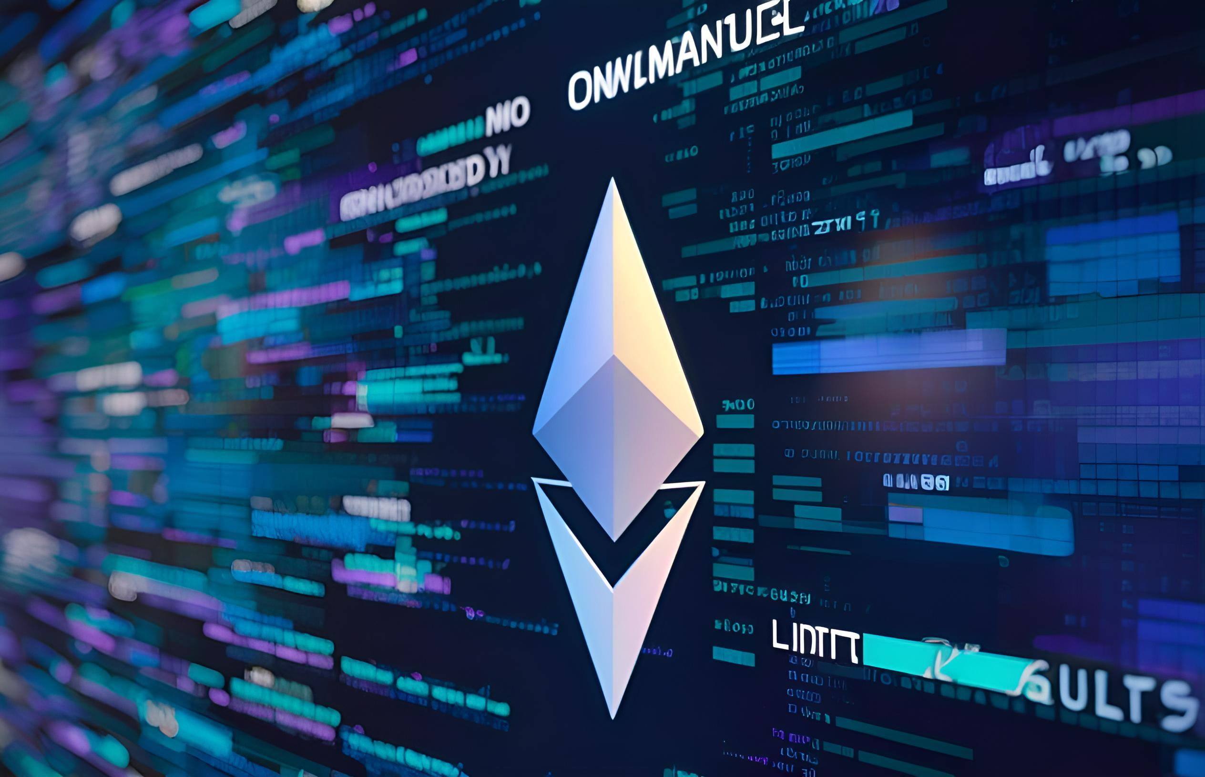
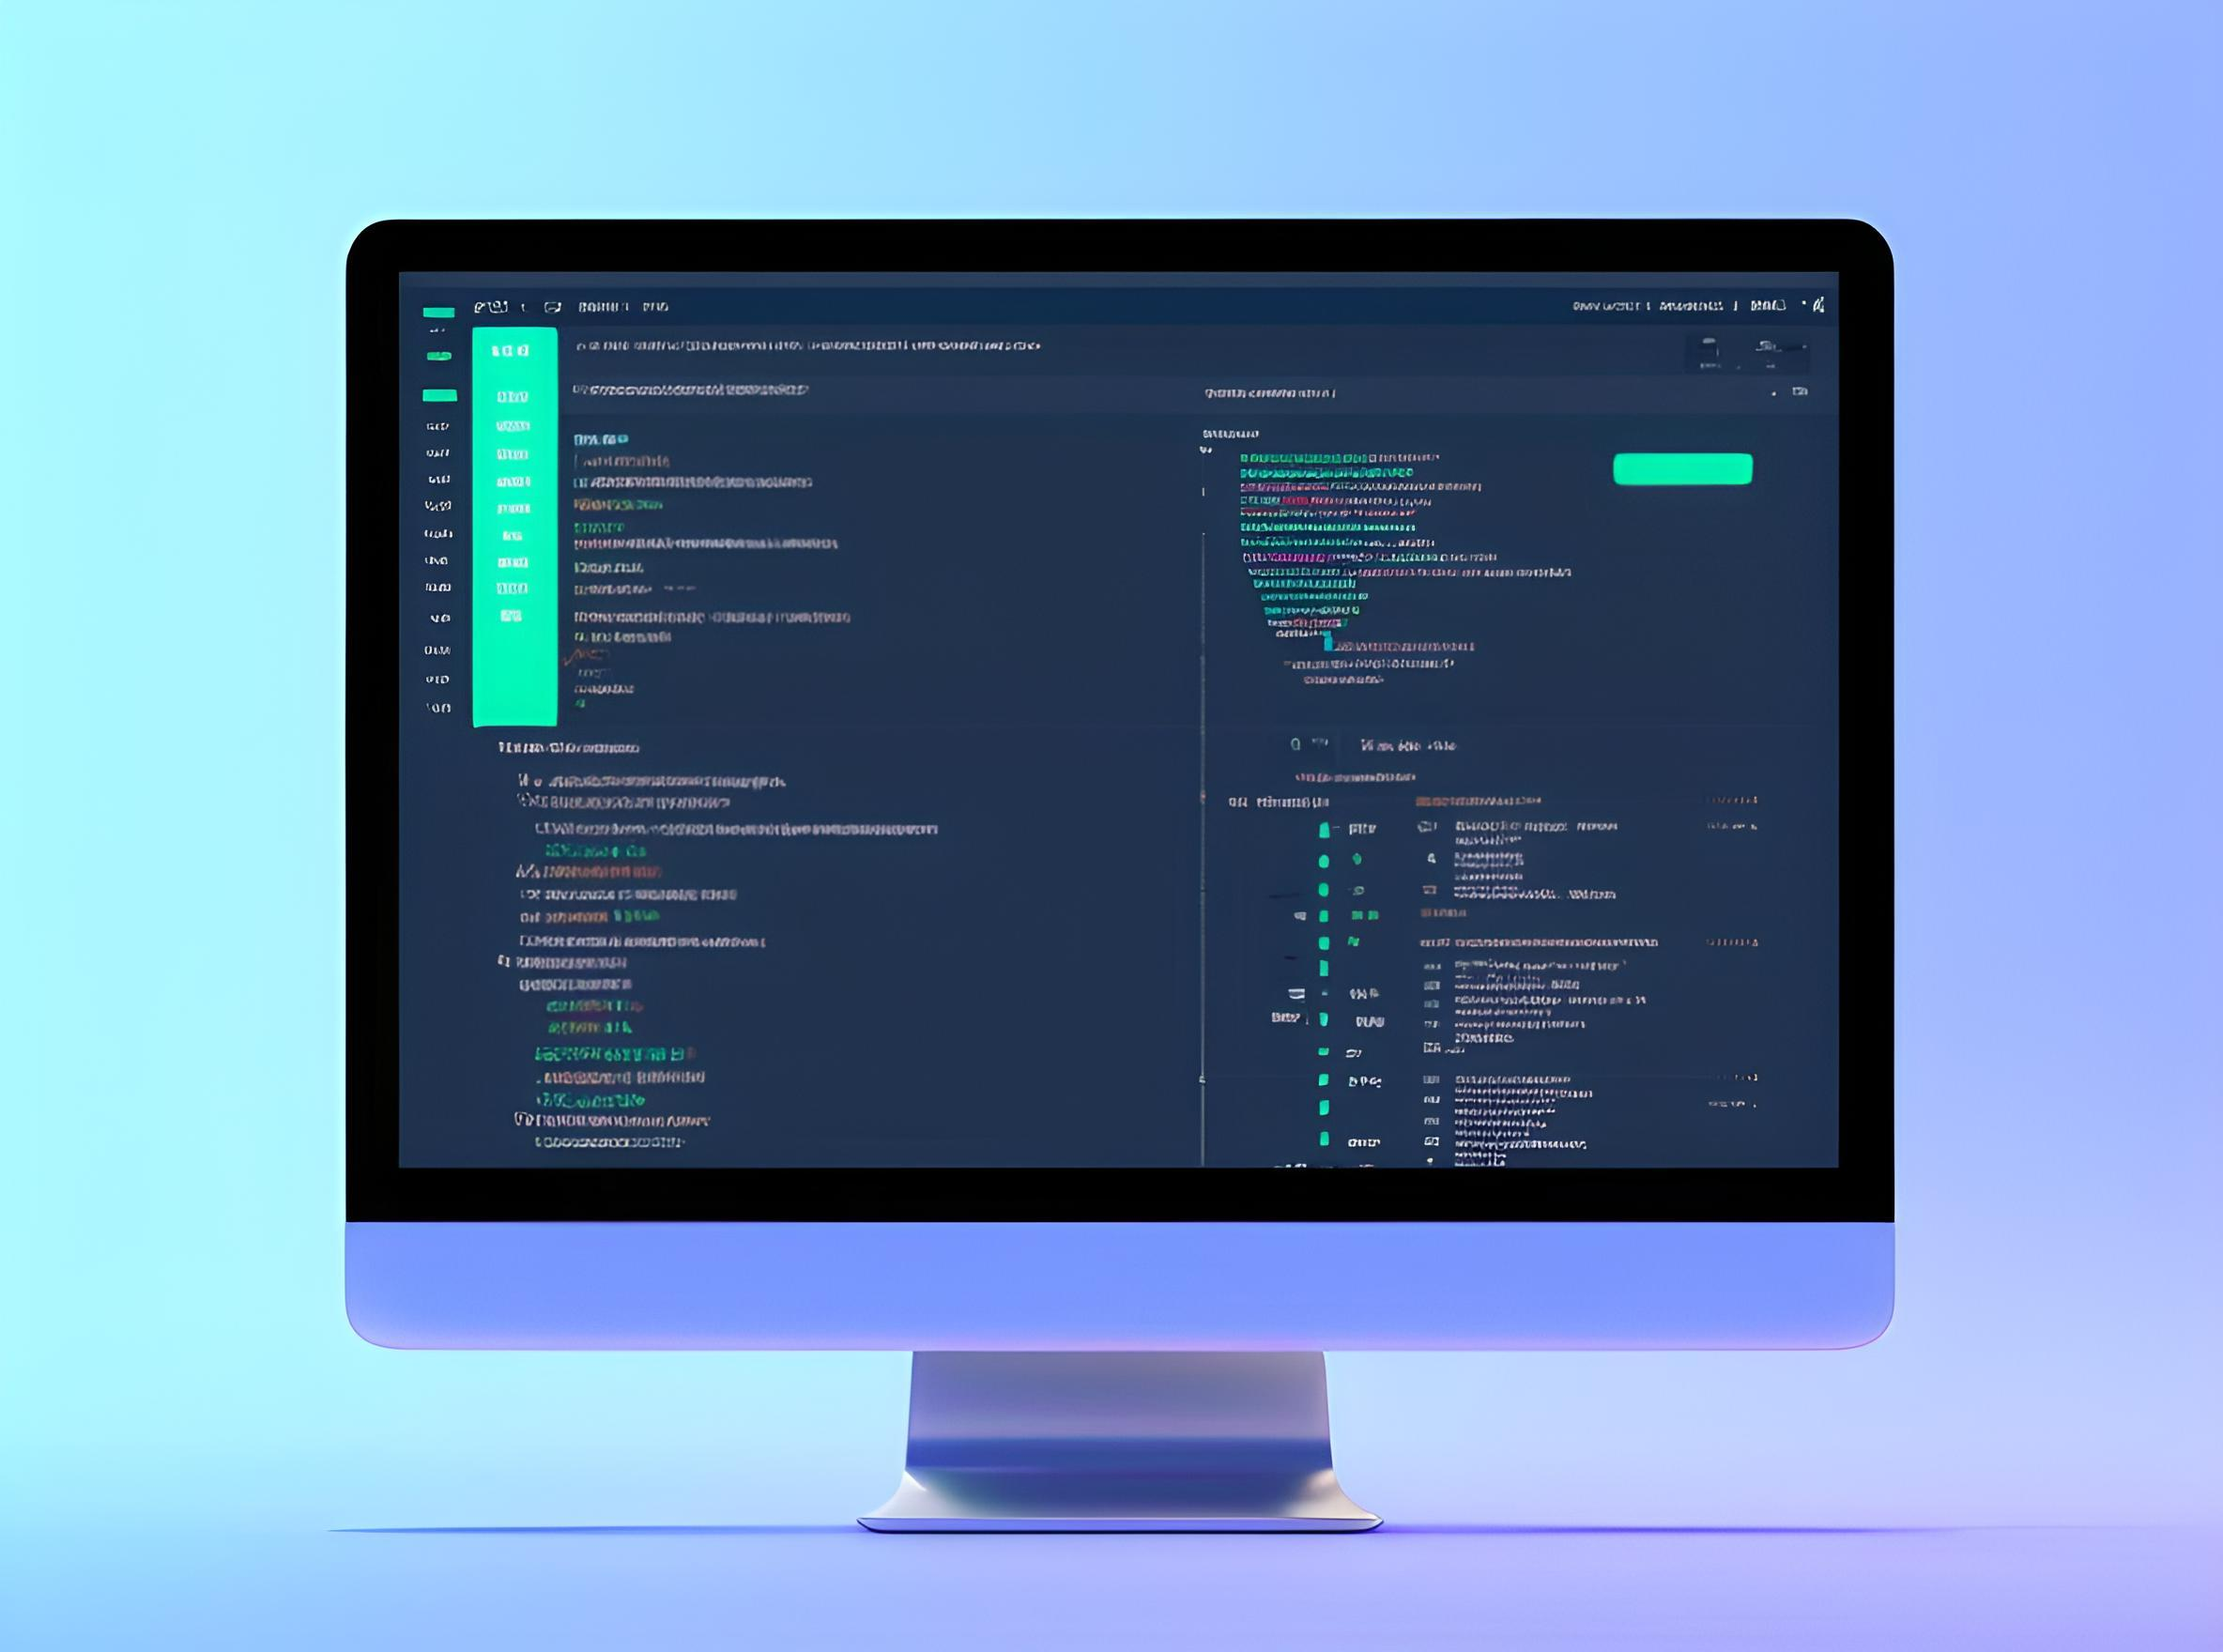
03
Tantin Chain
Smart Contracts & Developer Support
Smart Contract Platform
01
02
Virtual Machine
Language
Fully EVM-compatible. （ETH Virtual Machine）
Solidity (supports compilers ≥v0.4.24).
03
Tools
Integrated Remix IDE plugin for rapid testnet deployment.

Slide 11
03
Tantin Chain
Smart Contracts & Developer Support
Cross-Chain Compatibility
EVM Equivalence: Compatible with Ethereum RPC interfaces (e.g., eth_call, eth_sendRawTransaction).
Wallet Integration: Supports MetaMask and others.
Cross-Chain Bridges:
ERC-20 assets can be migrated 1:1 via bridge contracts.

Slide 12
04
Node Network Features

Slide 13
04
Tantin Chain
Node Network Features
Node Deployment
Hardware Requirements
Full Node: 4-core CPU, 8GB RAM, 500GB SSD (annual block data growth ≈120GB).
•
Light Node: Runs on Raspberry Pi 4B-level devices.
Node Incentives
Fee Distribution: 80% of transaction gas fees are used to buy back and burn CTC tokens.

Slide 14
05
Core Architecture: Modularity & AI-Driven Optimization

Slide 15
05
Core Architecture:
Modularity & AI-Driven Optimization
Three-Layer Modular Design
01
02
03
01.Execution Layer:
Supports parallel VMs (EVM, MoveVM, WASM). Developers can migrate existing dApps with minimal code changes.
02.Consensus Layer:
Dynamic Hybrid Consensus—PoS for daily transactions, Proof-of-History (PoH) for governance votes, with AI adjusting node incentives.
03.Data Availability Layer:
Integrates decentralized storage (only hashes stored on-chain, reducing full-node storage costs by 90%).

Slide 16
05
Core Architecture:
Modularity & AI-Driven Optimization
AI-Native
Optimization
Dynamic Gas Pricing:
AI adjusts fees based on network congestion and transaction type (DeFi/NFT/gaming), avoiding spikes like Ethereum’s NFT minting frenzies.
Resource Scheduling:
AI predicts high-traffic periods to pre-allocate computational resources.

Slide 17
06
User Experience Revolution: Chain Abstraction & Socialized Entry

Slide 18
06
User Experience Revolution:
Chain Abstraction & Socialized Entry
Chain Abstraction
Layer
Unified Account
Zero-Knowledge Security
One wallet address for all connected chains (like Web2 single sign-on), with cross-chain gas auto-settlement.
Default zk-SNARKs for privacy (amounts/addresses hidden). Compliance modules (e.g., KYC) configurable for enterprises.

Slide 19
06
User Experience Revolution:
Chain Abstraction & Socialized Entry
Gamified Traffic Entry
SocialFi Integration
Twitter/Telegram plugins let users sign transactions and vote in DAOs directly on social platforms.
On-Chain Achievement Economy
dApp growth metrics (DAU, volume) auto-convert to token rewards, forming a "user-developer-chain" flywheel.

Slide 20
07
Developer Ecosystem:
Low Migration Cost & Modular Factories

Slide 21
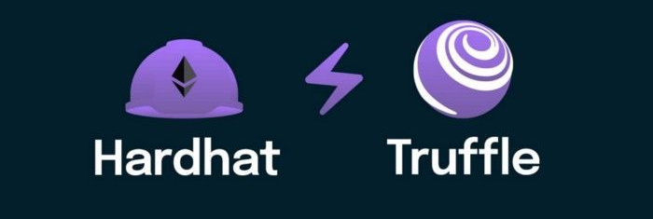
07
Developer Ecosystem:
Low Migration Cost & Modular Factories
Compatibility as a Service
EVM++ Sandbox
Direct deployment via Ethereum tools
(Hardhat, Truffle).
Cross-Chain Liquidity Bridges
One-click asset bridging solves cold-start challenges.

Slide 22
07
Developer Ecosystem:
Low Migration Cost & Modular Factories
Revenue Enhancement
Developer Pool
Traffic Sharing
80% of gas fees burned to buy back tokens.
Top dApps refer users to new apps, earning token incentives based on conversions.
Tantin Chain’s core advantage lies in lowering barriers for developers and users, modularity for diverse needs, and chain abstraction to break ecosystem silos. Instead of competing with Ethereum on ecosystem density or Solana on TPS, it redefines competition—shifting from "tech spec wars" to "experience and cost revolution."

Slide 23
Deep Dive
Tantin Chain
"Packing Ethereum’s ecosystem depth, Solana’s transaction speed, Cosmos’ interoperability, and ChatGPT’s user-friendliness into a single chain, all while delivering a TikTok-like smooth experience."
3 Straightforward Comparisons
That Show Why TT Chain Dominates Existing Public Blockchains

Slide 24
01
For Developers:
"Even Copying Homework Earns Money"
Comparison | Ethereum | Solana | TT Chain
Migration Cost | Rewriting contracts + gas spikes | Switching to Rust | Code reuse, near-zero migration cost
Earning Speed | Waiting for users to find your dApp | Battling bots for priority | Auto-traffic + revenue sharing
Anti-Fraud Guide | Hiring auditors | Praying to avoid flash-loan attacks | 24/7 AI-powered security

Slide 25
02
For Users:
"Even Novices Master Web3"
Pain Point | Existing Chains | TT Chain Solution
Gas Fees | NFT fees > NFT prices | Gas fees crushed to the floor
Cross-Chain UX | Manual chain-switching like airport transfers | Auto-routing smoother than ordering takeout
Privacy | Address exposed = hack waiting | Enable "Stealth Mode"

Slide 26
03
For Capital:
"Precision in Every Dollar"
Anxiety | Traditional Chains | TT Chain
User Retention | Players cash out and leave | Gamified tools make users "collect and stay addicted"
Ecosystem Launch | Burning cash for fake growth | AI matches real users to dApps
Anxiety | Traditional Chains | TT Chain
Real-World Scenario:
VCs investing in GameFi no longer gamble on single teams—
TT Chain’s on-chain data auto-flags the top 10 fastest-growing games, capturing traffic bonus (dividends).

Slide 27
Why TT Chain > Ethereum/Solana?
Killer Mechanisms:
Against Ethereum: "Use its ecosystem, steal its users"—EVM compatibility + Layer 1 infra + Layer 2 fees.
Against Solana: "Cheaper and more stable"—dynamic resource allocation prevents outages.
Against New Chains: "Your innovation, my legacy"—modular architecture absorbs cutting-edge tech.
Post-Launch Metrics:
Developer Migration: 80% of Ethereum’s Top 50 dApps replicated in 8 weeks.
User Switching Cost: <30 seconds.
Capital Efficiency: AI-optimized ecosystem fund ROI up 8x.
Downward-Compatible Experience:
Web2.5 UX: Intuitive, low-barrier entry.
Financial-Grade Security: Temp addresses generated per transaction (faster than VPN switching).
Anti-Sybil Design: Fair and attack-resistant.

Slide 28
Ultimate Benchmark
"The iOS of Blockchain Infrastructure"
3
1
2
01.For developers
AppStore-like tools and traffic.•
02.For users
iPhone-like simplicity with cutting-edge tech.•
03.For enterprises
Apple Tax-like passive (revenue) from ecosystem growth.

Slide 29
Layman’s Terms
If Ethereum is blockchain’s "Windows 95," Solana an "overclocked Android," then TT Chain is the "MacBook"—you might not pinpoint its "best feature," but after using it, other chains feel like abacuses.
Tantin Chain
The No.1 Super Traffic Public Chain, A Never-Congested Web3 Hub

